Slide 1
Programming Fundamentals
Lecture 17-18

Slide 2
Objectives
Functions
Built-in and User Defined Functions
Types of Functions
Pass by Value and Pass by Reference
Passing Arrays as Argument
Returning Array from functions

Slide 3
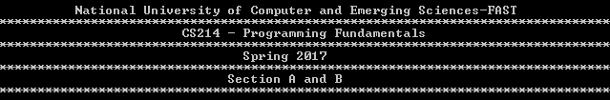
Sample Output
Suppose that we need the following output on screen
There are two codes to achieve above result

Slide 4
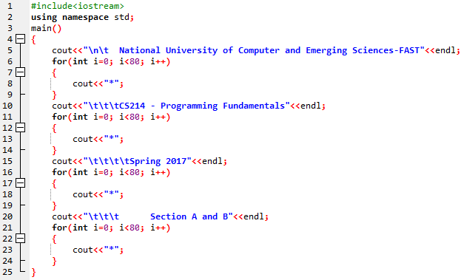
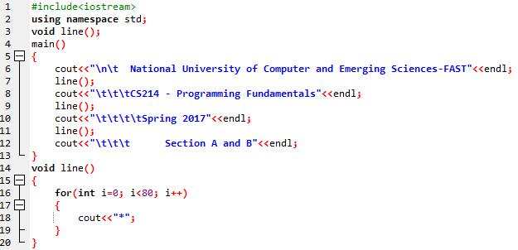
Sample Output (2 Solutions)

Slide 5
Function
A function is a group of statements that together perform a specific task and often returns a value
Every C++ program has at least one function, which is main()
You can divide up your code into pieces by separate functions
How you divide up your code among different functions is up to you, but logically the division usually is so each function performs a specific task

Slide 6
Types of Functions
Function in C++ are of two types
Built-in functions
The functions which comes with the library are built-in functions
log(x), pow(), sqrt(), etc
User defined functions
The functions which are coded by the users for specific tasks are called user defined functions
The function made to print a line etc

Slide 7
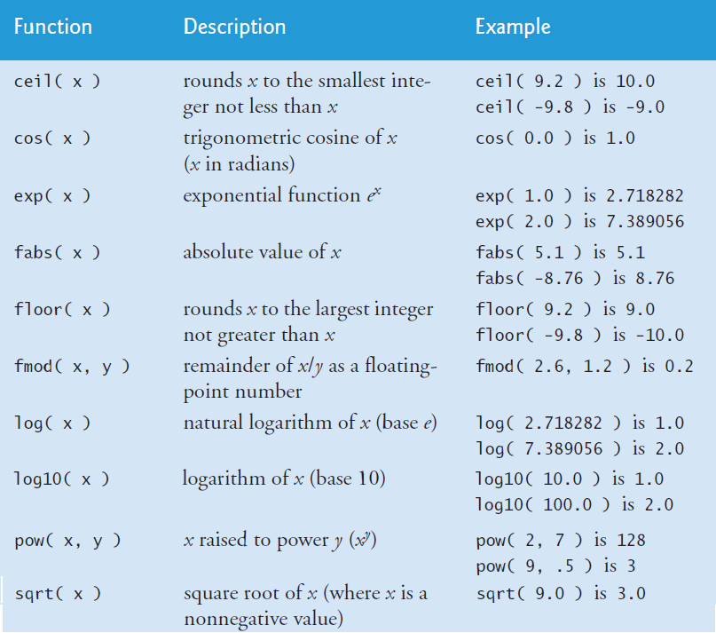
Built-in Function Examples
You Need to Add math header file to use these functions

Slide 8
User Defined Functions
We can directly use the built-in functions by direct calling them
For user defined functions we can use the function in following sequence
Declare→ Define→ Call (use)

Slide 9
Function Declaration
A function declaration is made by declaring
Return type of the function
Name of the function (Any valid identifier)
Data types of the parameters
Return_type function_name(parameter list);
int max(int x, int y);
Function declaration is optional
If we are defining the functions in the end, then we need to declare the functions first
Otherwise there is no need to declare a function

Slide 10
Function Definition
A function definition provides the actual body of the function. Parts of a function’s definition are:
Return Type
A function may return a value. The return_type is the data type of the value the function returns. For example void, int or float
Function Name
This is just an identifier
Parameters
A parameter is like a placeholder. When a function is invoked, you pass a value to the parameter. This value is referred to as actual parameter or argument. The parameter list refers to the type, order, and number of the parameters of a function. Parameters are optional; that is, a function may contain no parameters.
Function Body
The function body contains a collection of statements that define what the function does.

Slide 11
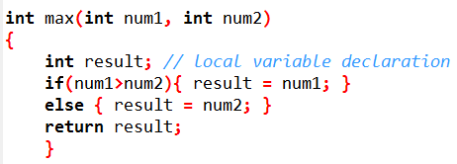
Function Definition– Example
Return_type function_name(parameter list)
{
Body of the function;
}

Slide 12
Calling a Function
To use a function we need to invoke the function in our main program
To call a function we simply need to pass the required parameters along with function name and return type
When a program calls a function, program control is transferred to the called function. A called function performs defined task and when its return statement is executed or when its function-ending closing brace is reached, it returns program control back to the main program

Slide 13
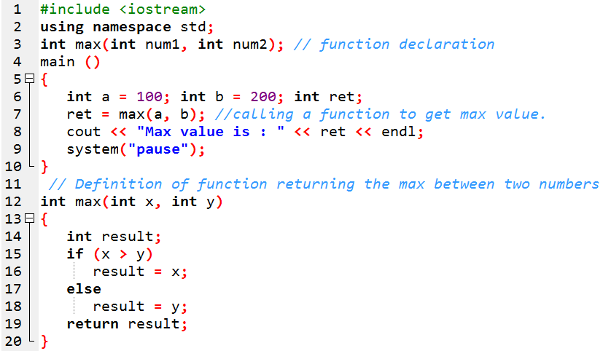
Example of User Defined Function

Slide 14
Function Arguments
If a function is to use arguments, it must declare variables that accept the values of the arguments. These variables are called the formal parameters of the function
The formal parameters behave like other local variables inside the function and are created upon entry into the function and destroyed upon exit

Slide 15
A function parameter (sometimes called a formal parameter) is a variable declared in the function declaration:
1 void foo(int x); // declaration (function prototype) -- x is a parameter
2
3 void foo(int x) // definition (also a declaration) -- x is a parameter
4 {
5 }
An argument (sometimes called an actual parameter) is the value that is passed to the function by the caller:
1 foo(6); // 6 is the argument passed to parameter x
2 foo(y+1); // the value of y+1 is the argument passed to parameter x

Slide 16
When a function is called, all of the parameters of the function are created as variables, and the value of the arguments are copied into the parameters. For example:
1 void foo(int x, int y)
2 {
3 }
4
5 foo(6, 7);
When foo() is called with arguments 6 and 7, foo’s parameter x is created and assigned the value of 6, and foo’s parameter y is created and assigned the value of 7.
1 void foo(int x, int y) // x and y are created here
2 {
3 } // x and y are destroyed here

Slide 17
When to use Arguments?
The arguments are not necessary when:
The function is performing some independent operation on some fixed data
User is asked to enter all the required information for specific operation in the body of the function
We will use the arguments when:
The operations performed by the function are depending upon some other value generated in the main code
When input is entered by the user before calling the user

Slide 18
Passing the Arguments
While calling a function, there are two ways that arguments can be passed to a function
Pass by value
Pass by reference

Slide 19
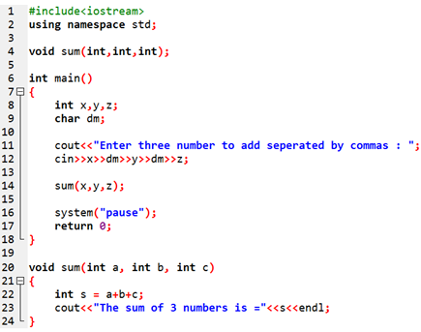
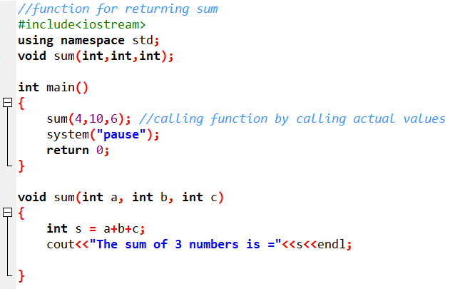
Argument Call by Value
This method copies the actual value of an argument into the formal parameter of the function.
Passing arguments in such a way, where the function creates copies of the arguments passed to it, is called passing by value

Slide 20
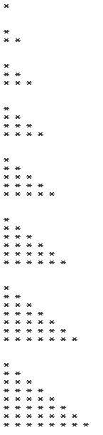
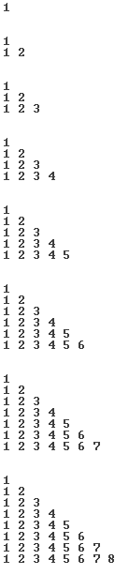
Practice Problem 1
Write an efficient code to print the following pattern

Slide 21
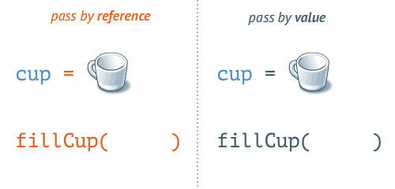
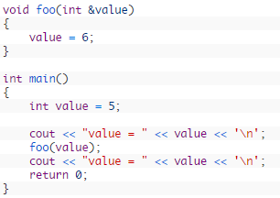
Passing Arguments by Reference
Passing by value has some limitations and can be inefficient and slow while passing arrays and structures
So to overcome this problem we use the call by reference method
The call by reference method of passing arguments to a function copies the reference of an argument into the formal parameter
In call by reference we modify the original argument of function by directly using its address

Slide 22
Advantages of Pass By Reference
It allows a function to change the value of the argument
Because a copy of the argument is not made, it is fast, even when used with large structures or classes
References can be used to return multiple values from a function

Slide 23
Returning Multiple Values from Functions
Functions can only have one return value
One way to return multiple values is using reference parameters
As in reference parameters the values are updated on the address, and that address is passed to the passing argument
So we can access the updated value even after the execution of the function
In these types of functions the return type of function is still void because it is actually returning nothing but we are using the updated values directly by accessing their address

Slide 24
Practice Problem 2
Write a function to compute and return the values of sin, cos and tan for a specific angle in degrees. Then make a program to test your function.

Slide 25
When to Use which method to Pass?
Pass by reference is used:
When passing structures, large arrays or classes
When you need the function to modify an argument
When you need to return more than one values
Pass by value is used:
When passing fundamental types

Slide 26
Practice Problem 3
Write a function to swap the values of two integers and then use this function in the main

Slide 27
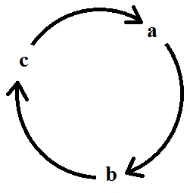
Practice Problem 4
Write a function to “clock wise cycle swap” 3 integers. In main program ask the user to enter three integers, display them before swapping, call the function and then display the numbers after cyclic swap.
Before swapping
a = 10, b = 20, c =30
After Swapping
a = 30, b = 10, c = 20

Slide 28
Default Values for Parameters
When we define a function, we can specify a default value for each of the last parameters.
This value will be used if the corresponding argument is left blank when calling to the function
This is done by using the assignment operator
If a value for that parameter is not passed when the function is called, the default given value is used
But if a value is specified, this default value is ignored and the passed value is used instead

Slide 29
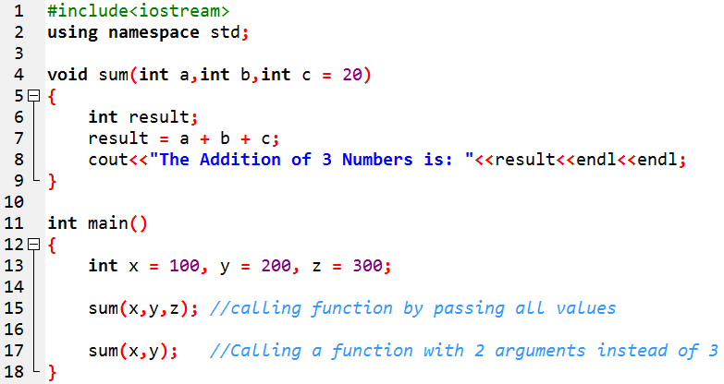
Default Values for Parameters– Example

Slide 30
Advantages of Functions
Functions helps us by
Making the coding easier and understandable
Dividing the task so that several programmers can work independently
Making the part of code reusable to less amount of work required to perform the same task

